Slide 1

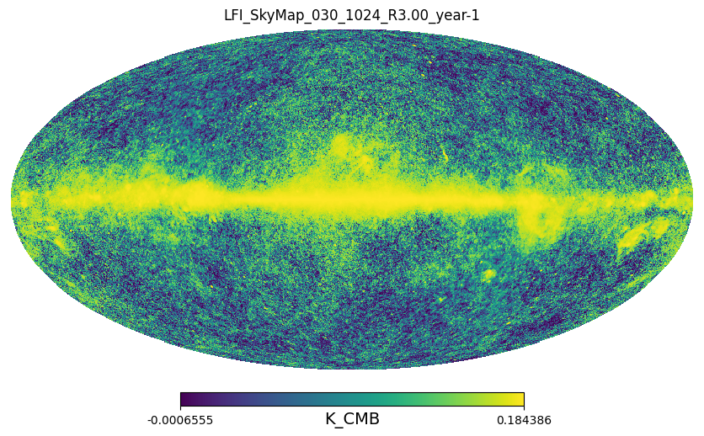
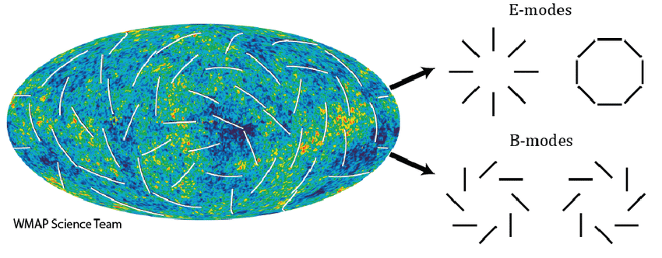
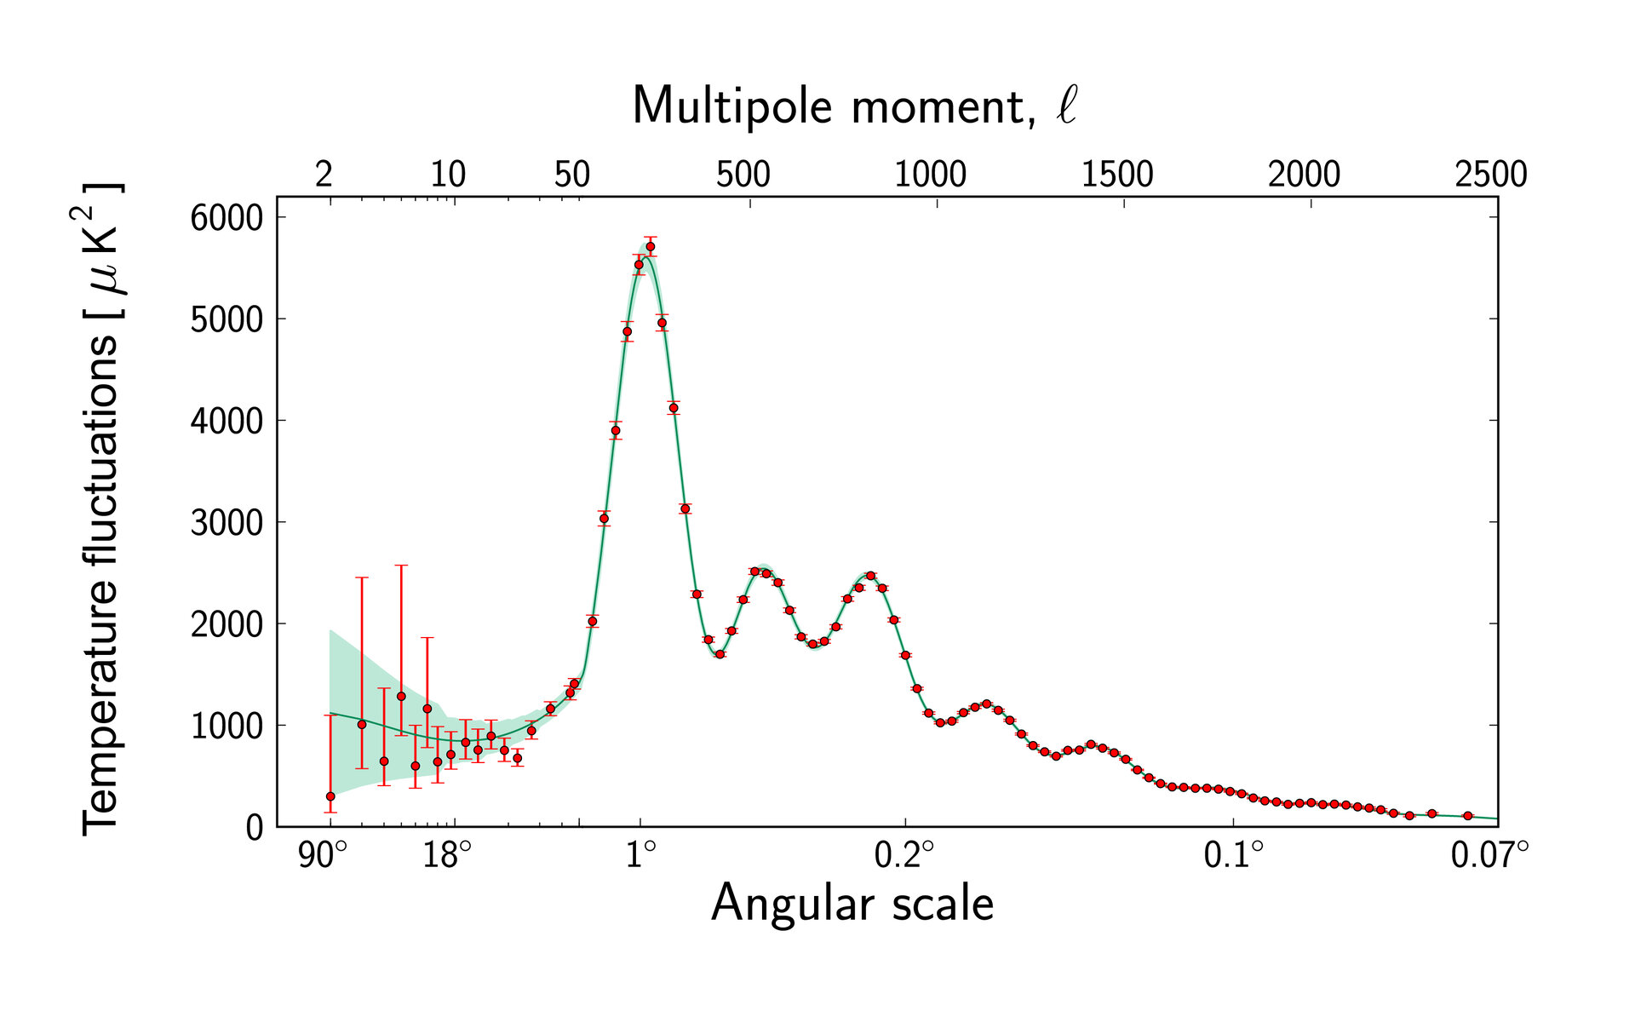
Exploring Cosmological Data with Python:
Analysis of Cosmic Microwave Background Experiments
Manasvini Komandur
Personal Background
Project Background Information
Using Python
The Cosmic Microwave Background Radiation (CMB) is the oldest light detectable and a remnant of the Big Bang. The CMB was created approximately 400,000 years after the Big Bang. At that point, the universe had cooled enough for photons to decouple from ordinary matter particles, allowing light to travel freely through the cosmos for the first time.
It is predominantly isotropic, supporting the theory of cosmic inflation. Cosmic inflation is the accelerated expansion of the early universe and is currently the leading explanation for the initial conditions and evolution of the universe.
Anisotropies in the CMB tell us about the structure and composition of the early universe.
The CMB is polarized due to its interaction with plasma in the early universe. This polarization can be split into two components: E modes, which are parallel or perpendicular to the direction of polarization, and B modes, which are 45 degrees with respect to the direction of polarization.
My project worked to explore cosmological data from leading CMB experiments in python, learning vital astronomical libraries like healpy and astropy and their most useful functions. I learned how to extract the power spectrum from a CMB map and how to interpret the properties of a CMB map such as pixelization and angular resolution.
Who am I?
Hello! My name is Manasvini and I am a first year student majoring in Physics at UCSD.
Why physical sciences and why physics?
I’ve always had a passion for the physical sciences, and most especially physics, because they’ve helped me to better understand how the world around me works. In particular, I’ve been interested in learning more about the fields of astrophysics and quantum physics and understanding what these sciences tell us about the structure of our universe.
Why did I join EXPAND?
I felt that EXPAND would provide me with an opportunity to learn about current research in the physical sciences and also help me to gain a better understanding of the research experience with my mentor’s guidance.
I was interested in this particular project because it allowed me to become familiar with the field of cosmology and learn about the different experiments and the research methods used in cosmology and astrophysics.
The search for B mode polarization is significant because it provides evidence for cosmic inflation.
CMB map from the Planck satellite Low Frequency Instrument, measured at 30 GHz
Looking ahead
Through this project, I became familiar with methods in observational and experimental cosmology, learned to use computer programming for visualizing and interpreting data from cosmological experiments, and wish to continue exploring the mathematical and physical principles behind the CMB’s properties. With guidance from my mentor, Alyssa Johnson, I plan to further my knowledge, and pursue internships and research opportunities as pathways to explore careers in physics.
E modes and B modes: J. Lazear et al., The Primordial Inflation Polarization Explorer
The CMB produces a power spectrum that shows the fluctuations in temperature as a function of angular scale. This spectrum provides insight into the distribution of matter in the early universe.
Power Spectrum: ESA and the Planck Collaboration, Planck Power Spectrum
EXPAND Poster Session, 2024
UCSD Physical Sciences — Student Success Center
Notes:
Astrophysics/cosmology intro:
CMB
inflation >>
isotropies/anisotropies
polarization (go into detail about E mode and B mode?)
power spectrum!! (include an example?)
Python intro:
opening fits files
opening CMB maps
opening power spectrum (? since this was mostly just Alyssa’s code?)

